Slide 1
Multiple Access Techniques for wireless communication
Multiple access schemes allow many mobile users to share a finite amount of radio spectrum
High quality of communications must be maintained during the sharing process

Slide 2
Multiple Access Techniques
Multiple Access Techniques
PR
FDMA
TDMA
CDMA
SDMA
Packet Radio (PR)
Frequency Division Multiple Access (FDMA)
Time Division Multiple Access (TDMA)
Code Division Multiple Access (CDMA)
Space Division Multiple Access (SDMA)

Slide 3
Multiple Access (MA) Technologies
Cellular System | MA Technique
AMPS ( Advanced Mobile Phone system ) | FDMA / FDD
GSM ( Global System for Mobile ) | TDMA / FDD
US DC ( U. S Digital Cellular ) | TDMA / FDD
JDC ( Japanese Digital Cellular ) | TDMA / FDD
IS – 95 ( U.S Narrowband Spread Spectrum ) | CDMA / FDD

Slide 4
Capacity of Cellular Systems
Channel capacity of a wireless system is the maximum number of users possible in the system
Channel capacity depends on:
  Bandwidth available
  Signal to Noise ratio (SNR) in the channel

Slide 5
Frequency Division Multiple Access (FDMA)
code
C₁
C₂
C_{N}
frequency
time
frequency
C₁
C₂
C_{N}

Slide 6
Principle of FDMA Operation
Each user is allocated a unique frequency band or channel. These channels are assigned on demand to users who request service
In FDD, the channel has two frequencies – forward channel & reverse channel

Slide 7
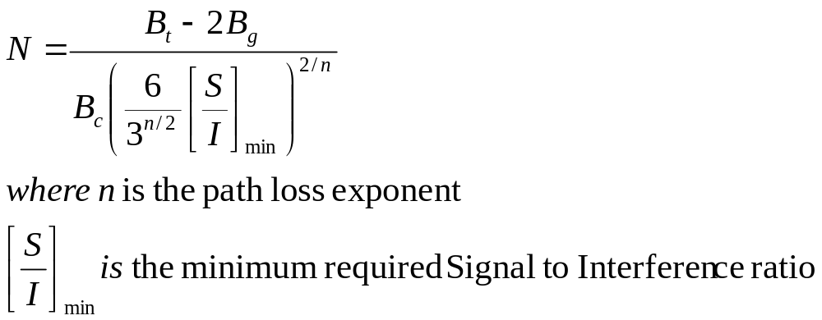
Cell capacity of FDMA System
Capacity/cell N

Slide 8
Example
In the US, each cellular carrier has 416 channels
Assuming negligible noise input:

Slide 9
Time Division Multiple Access (TDMA)
code
C₁
C_{N}
frequency
time
time
C₁
C₂
C_{N}

Slide 10
TDMA Operating principle
TDMA systems divide each FDMA channel into time slots
Each user occupies a cyclically repeating time slot.
TDMA can allow different number of time slots for separate user

Slide 11
TDMA Frame Structure
Preamble | Information message | Trail Bits
Slot 1 | Slot 2 |  | Slot N
Trail Bit | Sync Bit | Information Bit | Guard Bits

Slide 12
Components of TDMA Frame
Preamble → Address and synchronization information for base station and subscriber identification
Guard times → Synchronization of receivers between different slots and frames

Slide 13
TDMA properties
Data Transmission for user of TDMA system occurs in discrete bursts
  The result is low battery consumption.
  Handoff process is simpler
Since different slots are used for T and R, duplexers are not required.
Equalization is required, since transmission rates are higher than FDMA channels

Slide 14
Efficiency of TDMA
Frame Efficiency

Slide 15
Frame efficiency parameters

Slide 16
Frame efficiency parameter definition

Slide 17
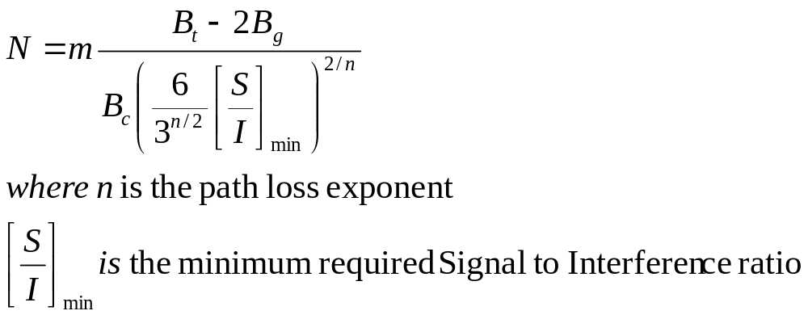
Cell capacity in TDMA System m is the number of TDMA users in one channel

Slide 18
Example
The GSM System uses a TDMA frame structure where each frame consist of 8 time slots, and each time slot contains 156.25 bits, and data is transmitted at 270.833 kbps in the channel.
Time duration of a bit
Time duration of a slot
Time duration of a frame

Slide 19
Solution
Time duration of a bit
Time duration of a slot
ms
Time duration of a frame

Slide 20
Example
If a normal GSM timeslot consists of 6 trailing bits, 8.25 guard bits, 26 training bits, and 2 traffic bursts of 58 bits of data, find the frame efficiency.
Solution
Time slot has 6+ 8.25+ 26 + 2(58) = 156.25 bits.
A frame has 8 * 156.25 = 1250 bits / frame.
The number of overhead bits per frame is:
b_{OH} = 8(6) + 8(8.25) + 8(26) = 322 bits
Frame efficiency = (1250 – 322 )/1250 = 74.24 %

Slide 21
Capacity of Digital Cellular CDMA
Capacity of FDMA and TDMA system is bandwidth limited.
Capacity of CDMA system is interference limited.
The link performance of CDMA increases as the number of users decreases.

Slide 22
Number of possible users in CDMA
η is the background thermal noise
S is the average user power
W is the total RF bandwidth
R is the information bit rate

Slide 23
Techniques to improve capacity
Antenna Sectorization
Sectoral antennas at 120 degrees increases the capacity by a factor of 3
Monitoring or Voice activity α
Each transmitter is switched off during period of no voice activity

Slide 24

Capacity Improvement
)

Slide 25
Example
If W = 1.25 MHz, R= 9600 bps, and a minimum acceptable E_{b}/ N_{o} is 10 dB, determine the maximum number of users that can be supported in a single cell CDMA system using:
omni directional base station antennas and no voice activity detection
3 sectors at base station and α = 3/8. Assume the system is interference limited. η = 0.

Slide 26
Solution
(a)

Slide 27
(b) Users per sector

Slide 28
Total users N in 3 sectors

